Slide 1


FALCON – Federated AI-Linked Cyber-Operational Network

Slide 2

01
Introduction

Slide 3
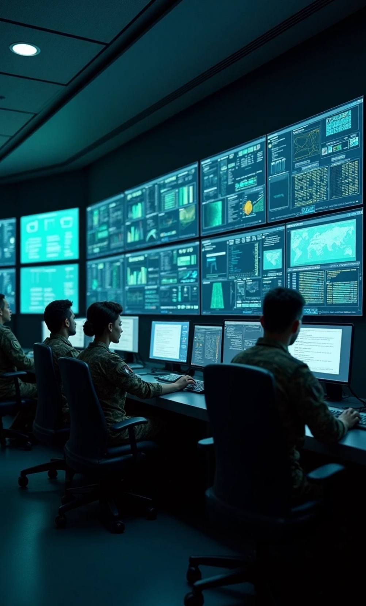

Project Overview
Project Name
FALCON
Full Form
Federated AI-Linked Cyber-Operational Network
Tagline
“Redefining Military Defence with AI-Powered Speed & Precision”

Slide 4

02
The Problem

Slide 5
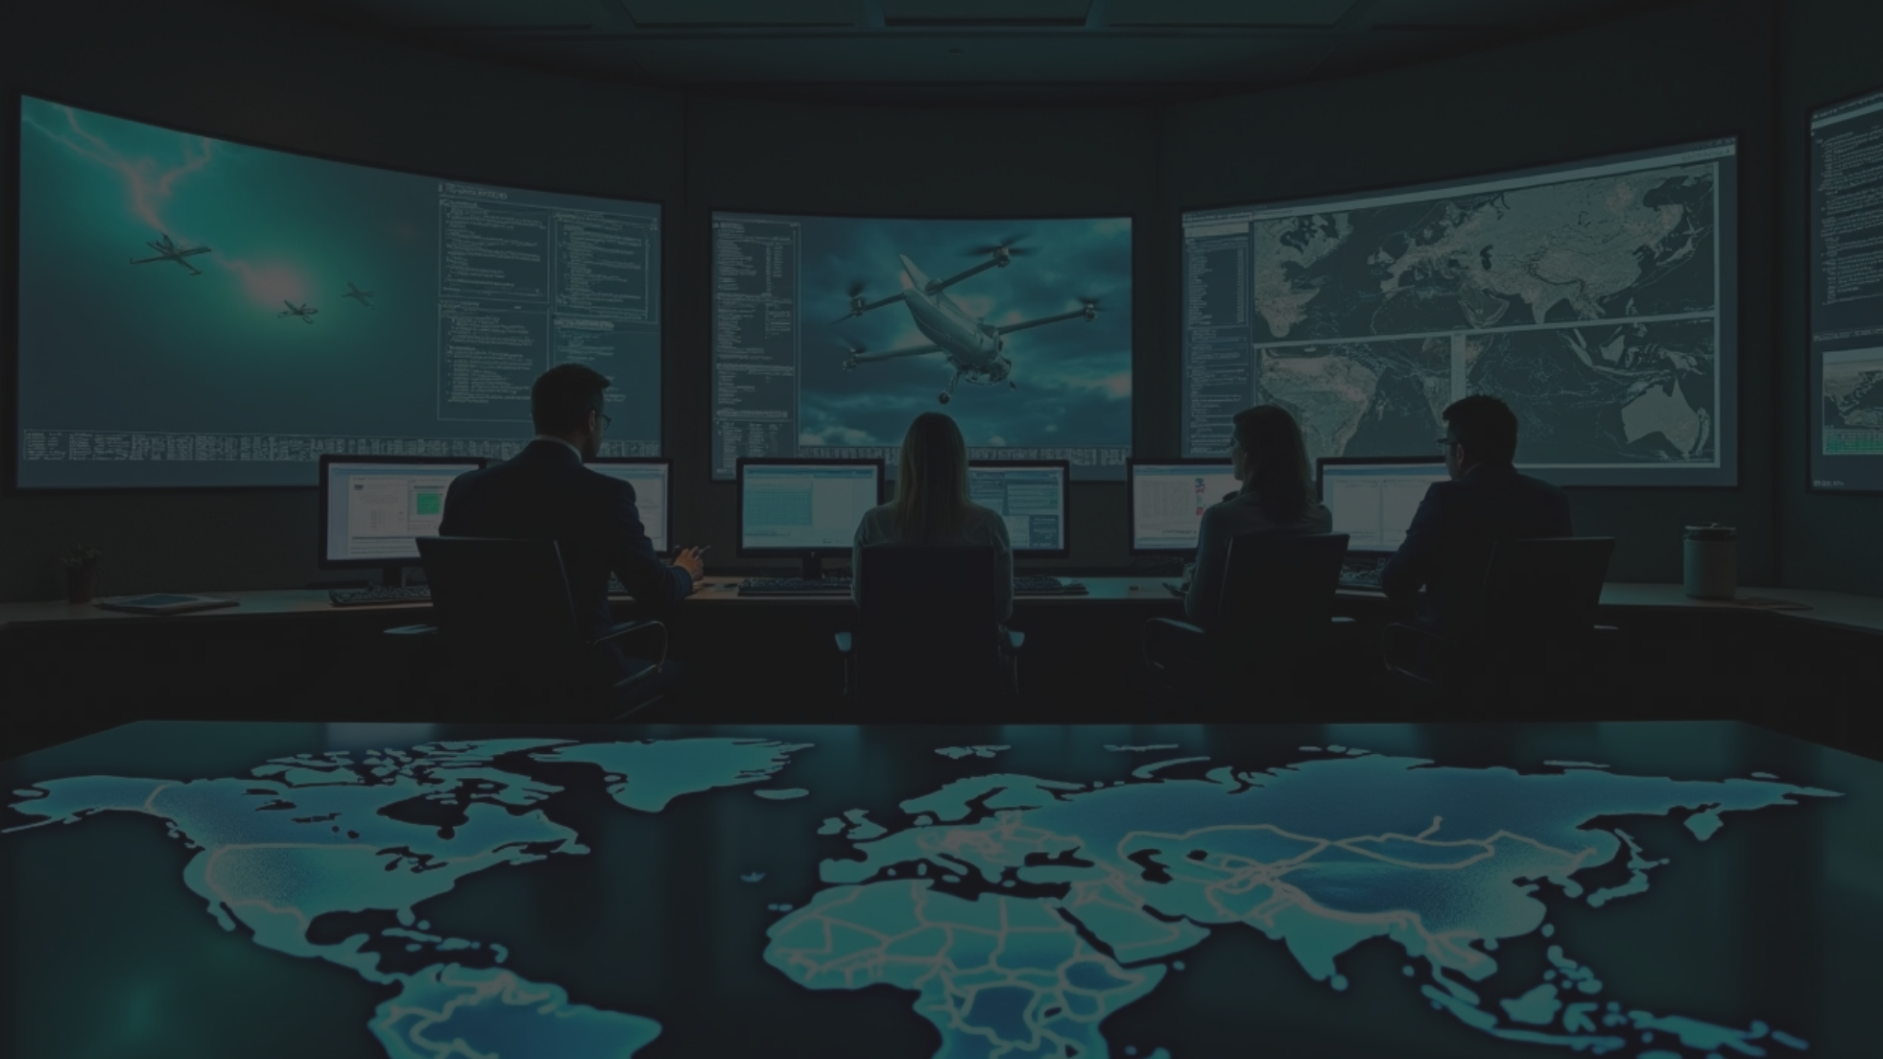


The Problem
Modern warfare relies on drones, hypersonic missiles, and cyber threats.
Defence systems today are reactive, not proactive.
Delayed decision-making due to human processing time.
Fragmented defence networks – each base acts alone → slower coordination.
Existing systems (Iron Dome, THAAD, S-400) focus on missiles only, not multi-threats like cyber + drone + missile at once.
Lack of real-time collaboration between bases → one base collapse can endanger all.

Slide 6

03
The Solution (FALCON)

Slide 7
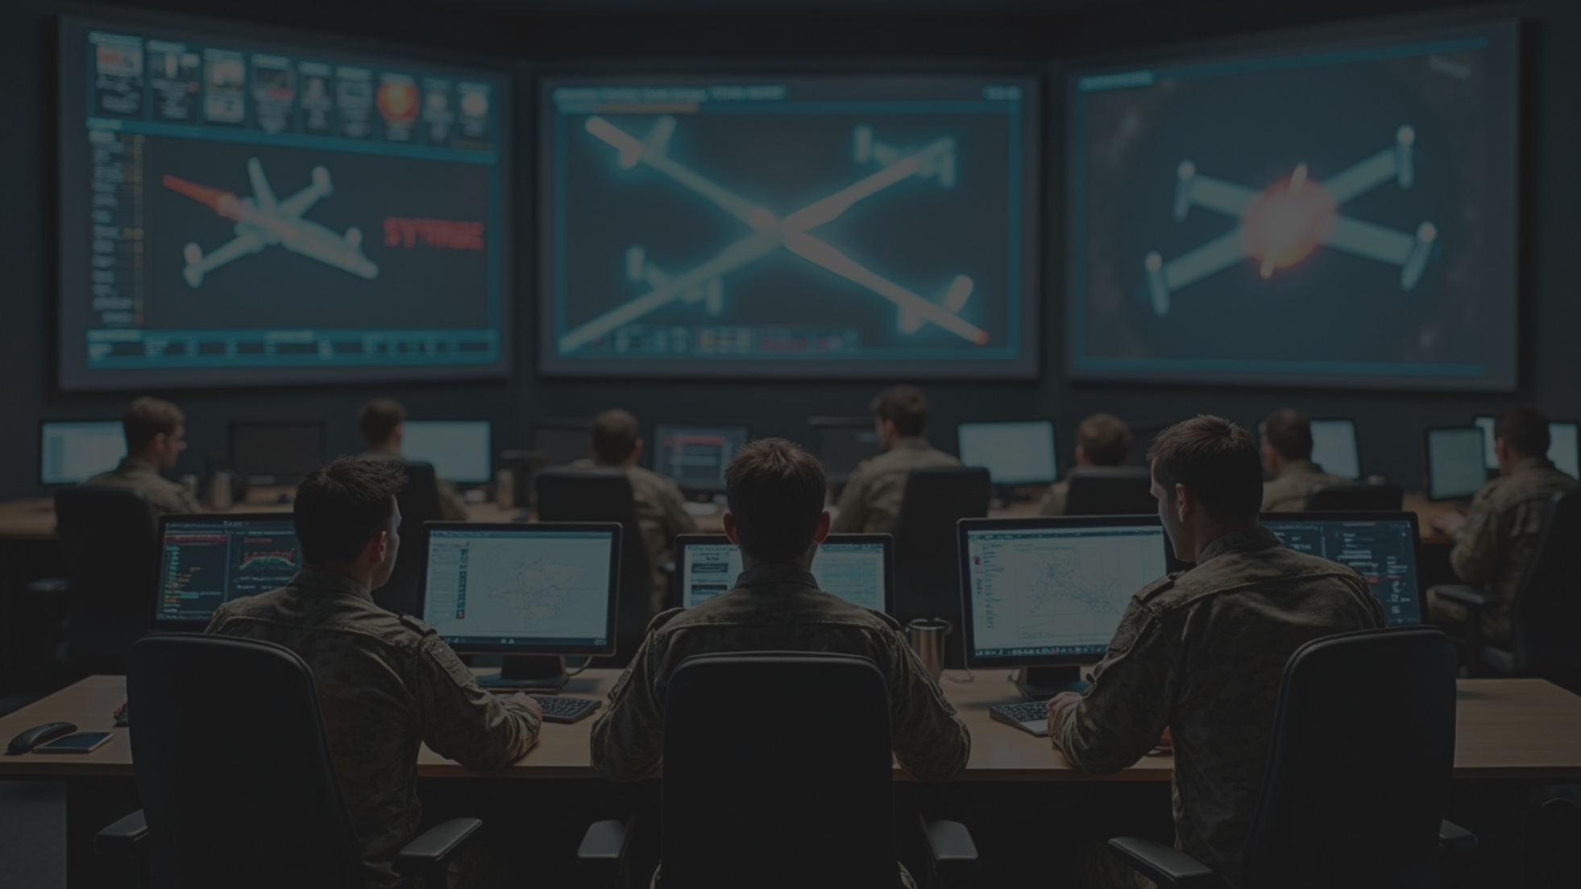

The Solution (FALCON)
FALCON is an AI-driven defence ecosystem that:
Detects threats faster than human operators.
Automatically alerts & coordinates all bases.
Predicts attack patterns before they occur.
Engages both defensive (intercept missiles/drones) and offensive (jam enemy drones, disable cyber-attacks).
Uses federated learning (FDIN) so bases learn from each other without sharing raw classified data.

Slide 8

04
FALCON Architecture (How it Works)

Slide 9
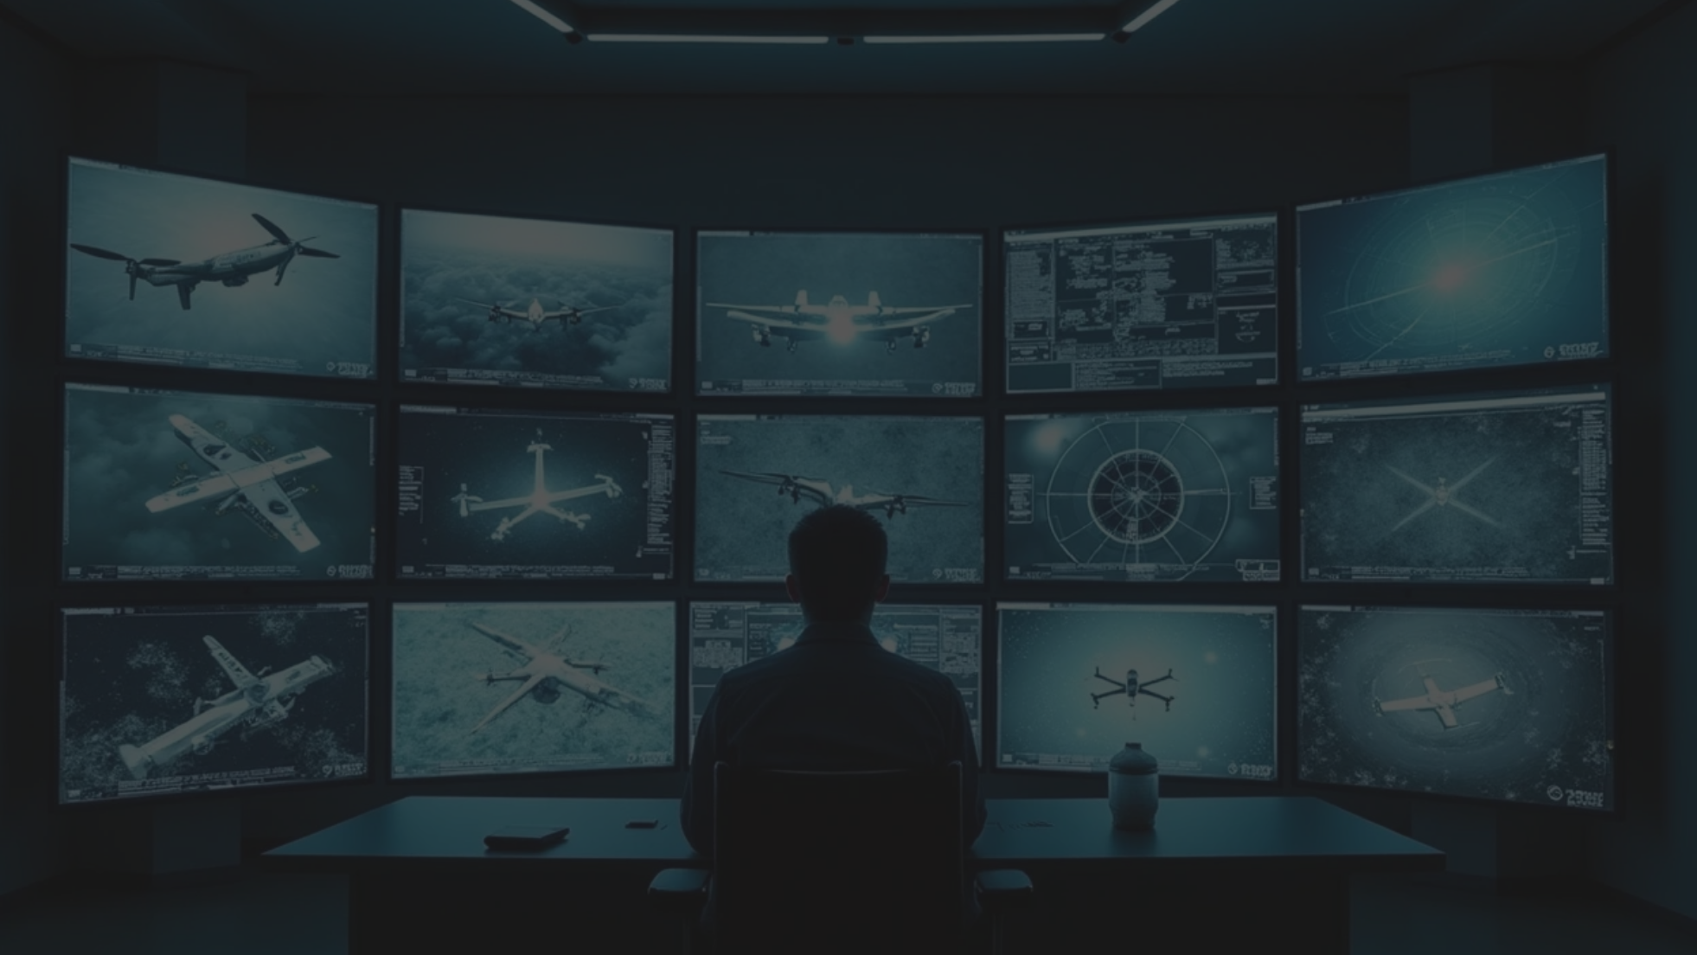


FALCON Architecture (How it Works)
Detection Layer
Processing Layer
• AI-powered radar + satellite + drone feeds.
• AI models analyze threat type, speed, trajectory.
• Identifies drones, missiles, cyber anomalies instantly.
• FDIN shares “threat knowledge” across bases securely.
Decision Layer
Action Layer
• AI ranks best response (intercept, jam, counter-attack).
• Defence systems launch interceptors.
• Sends instant alerts to all bases & troops.
• Offensive cyber/Air units are triggered automatically.
• Nearby bases auto-support attacked base.

Slide 10

05
Real-Life Example

Slide 11
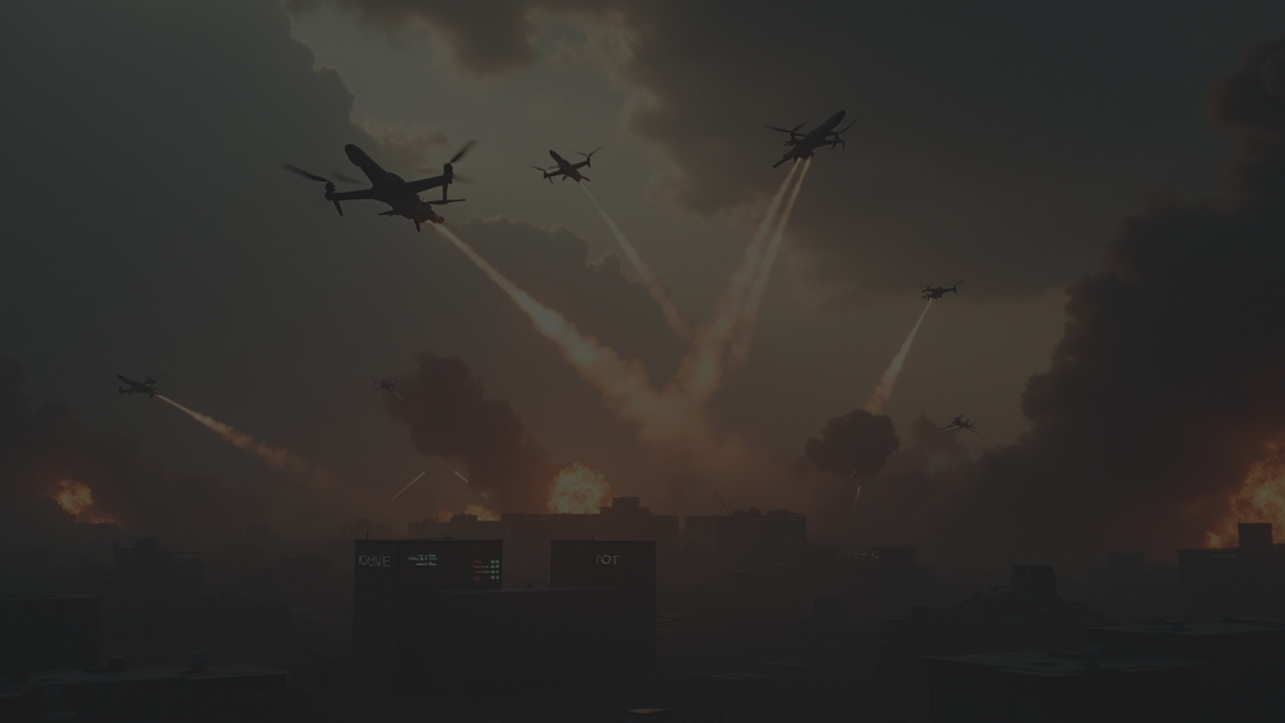

Real-Life Example
Scenario: Base A is attacked by a missile + drone swarm.
Traditional System → Base A tries alone → fails → destroyed.
FALCON System:
Missile detected by AI in 1 second.
Base A auto-alerts Base B & C through FDIN.
Base B launches interceptors, Base C jams drones.
Troops mobilized automatically.
Base A is saved → whole network survives.

Slide 12

06
Comparison with Existing Systems

Slide 13
Comparison with Existing Systems
Feature | Iron Dome | THAAD | S-400 | FALCON
Missile Defence | ✅ | ✅ | ✅ | ✅
Drone Defence | ❌ | ❌ | ⚠ Limited | ✅
Cyber Threat Handling | ❌ | ❌ | ❌ | ✅
AI-Powered Fast Action | ❌ | ❌ | ❌ | ✅
Base-to-Base Sharing | ❌ | ❌ | ❌ | ✅
Proactive Prediction | ❌ | ❌ | ❌ | ✅

Slide 14

07
Technologies Used

Slide 15
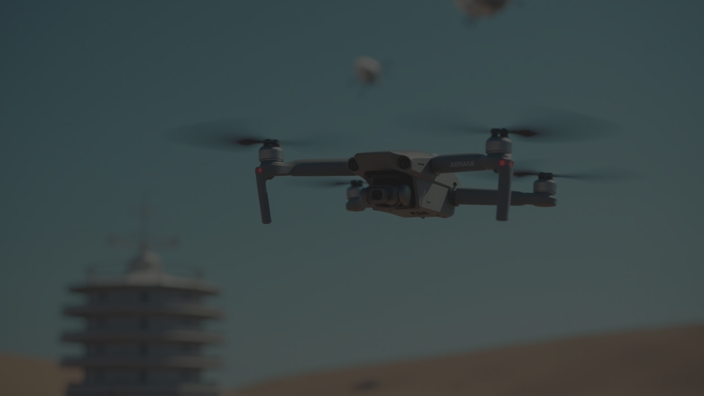
Technologies Used
AI/ML → real-time threat detection.
Federated Learning (FDIN) → secure base-to-base knowledge sharing.
IoT + Sensors → drones, radars, satellites integration.
Cyber Defence AI → detect and block hacking in real-time.
5G/Quantum Communication (future) → ultra-fast, hack-proof comms.

Slide 16
08
Unique Points of FALCON

Slide 17
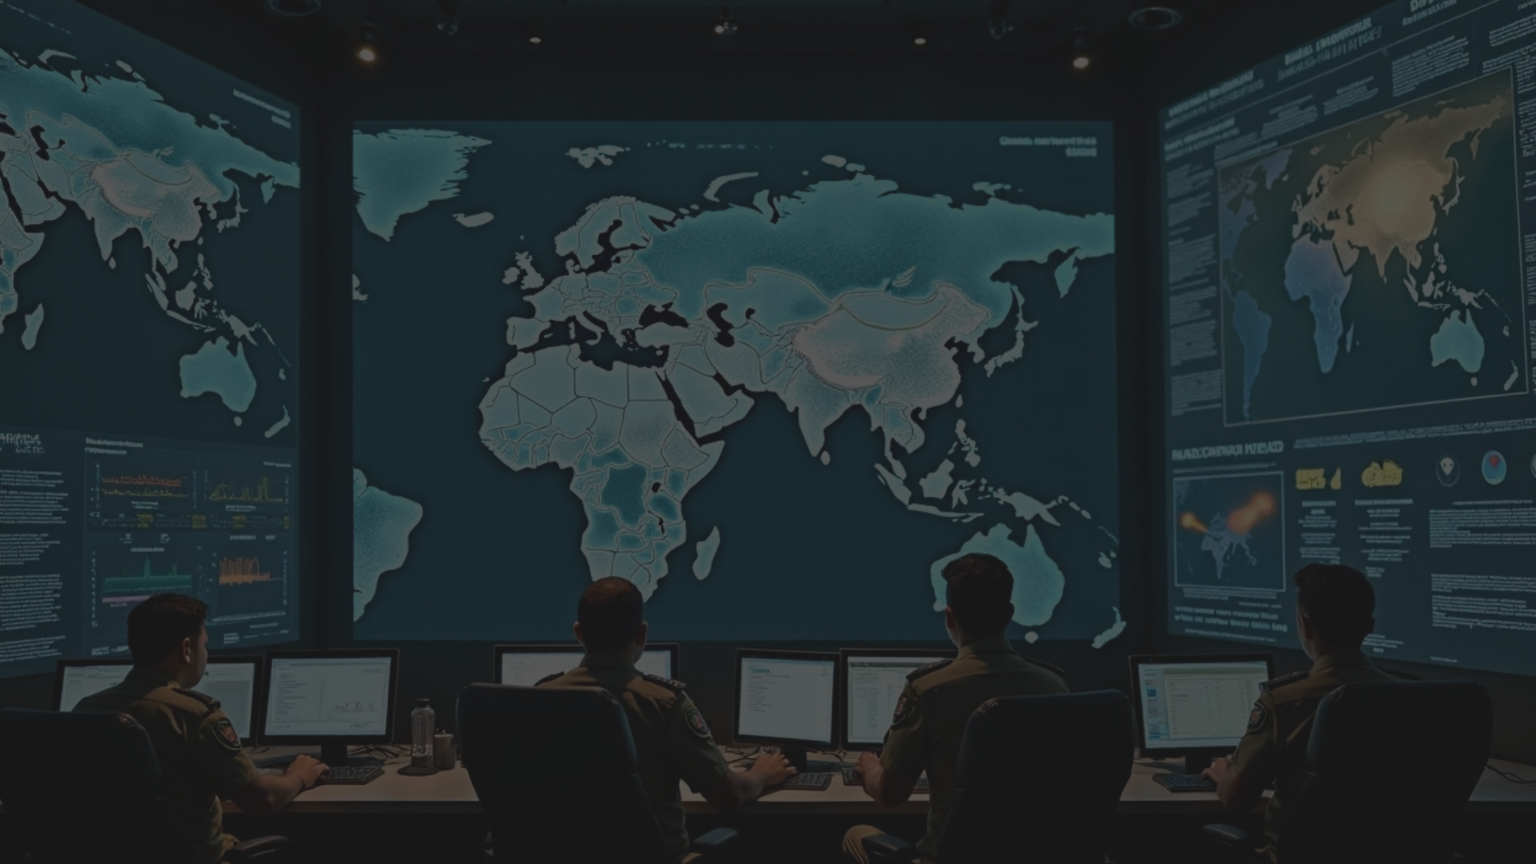

Unique Points of FALCON
Multi-threat handling (Missile + Drone + Cyber in one).
Proactive, not reactive → AI predicts next attack.
Self-learning → each attack makes system smarter.
Networked defence → no base fights alone.
Fully automated coordination → faster than humans.
First of its kind in India (no such project exists).

Slide 18
09
Impact & Future

Slide 19
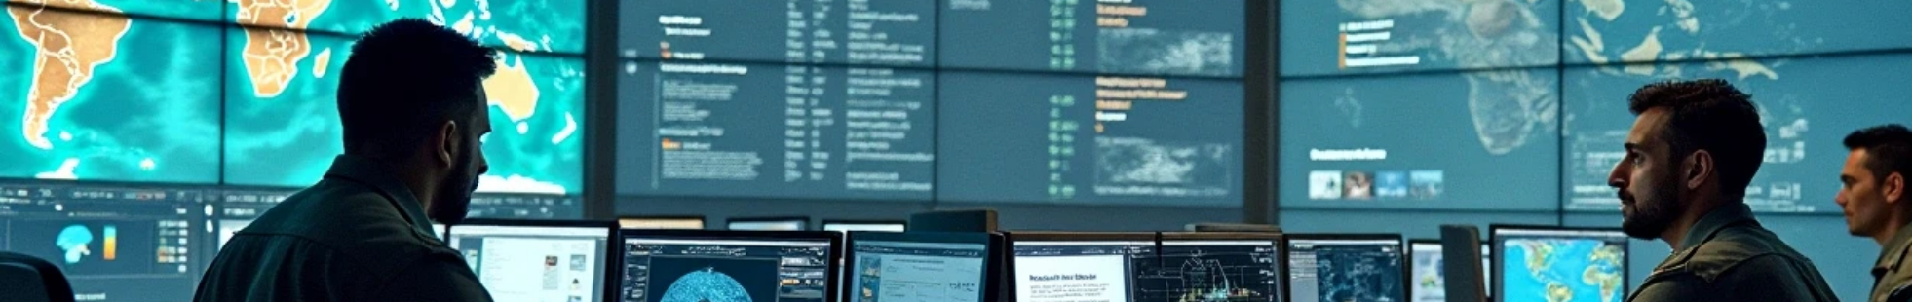
Immediate Benefits
Saves bases & troops by reducing reaction time.
Increases survivability of entire military networks.

Slide 20



Future Scope
1
Integration with satellite-based quantum communication.
2
AI-driven autonomous intercept drones.
3
Expansion to naval & airforce systems.

Slide 21

Thank You

